Slide 1
SevaOne ServicePlus Replacement
Proposal to EDCS: what exists today, the gaps, our proposed architecture and operating procedures
Draft for discussion · October 2026

Slide 2
ServicePlus today: configure once, serve many
1
2
3
4
Service owner configures
Forms, workflow, certificates and messages through drag-and-drop designers. No code.
Citizen applies
On the web portal, mobile app, or through an assisted-mode operator. Tracks status and gets alerts.
Officers process
Role-based worklists, remarks, approval or rejection, with up to three appeal levels.
Certificate delivered
QR code, digital stamp and a unique URL. Payments and messages run alongside.
Supporting capabilities
Payments: BharatKosh, PayU, BillDesk and more
Identity and signing: Aadhaar, DigiLocker, eSign
Money transfer: PFMS and DBT
Reports: SPReport dashboards
3,564
services configured
345 million
applications received
36 + 18
States/UTs and central departments
Source: NIC ServicePlus presentation (22 slides). Figures are undated claims, not verified measurements.

Slide 3
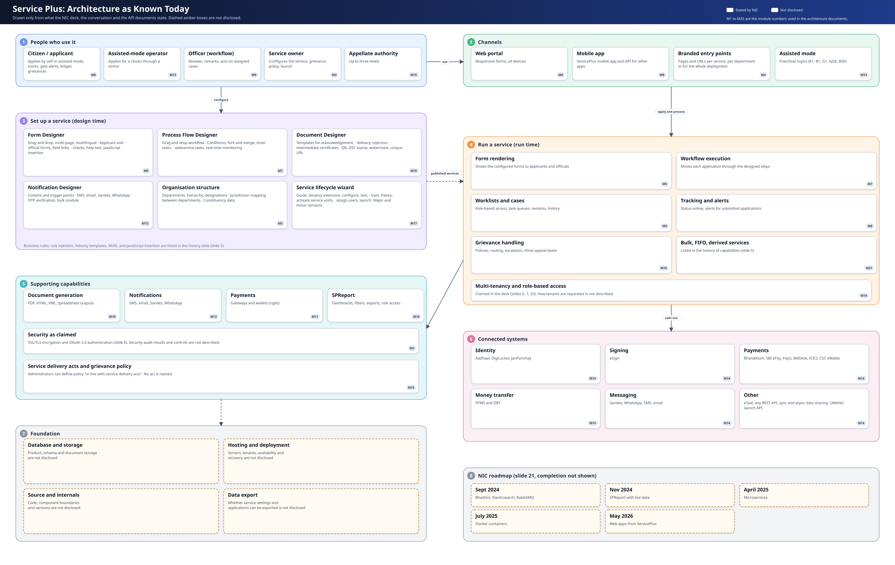

Slide 4
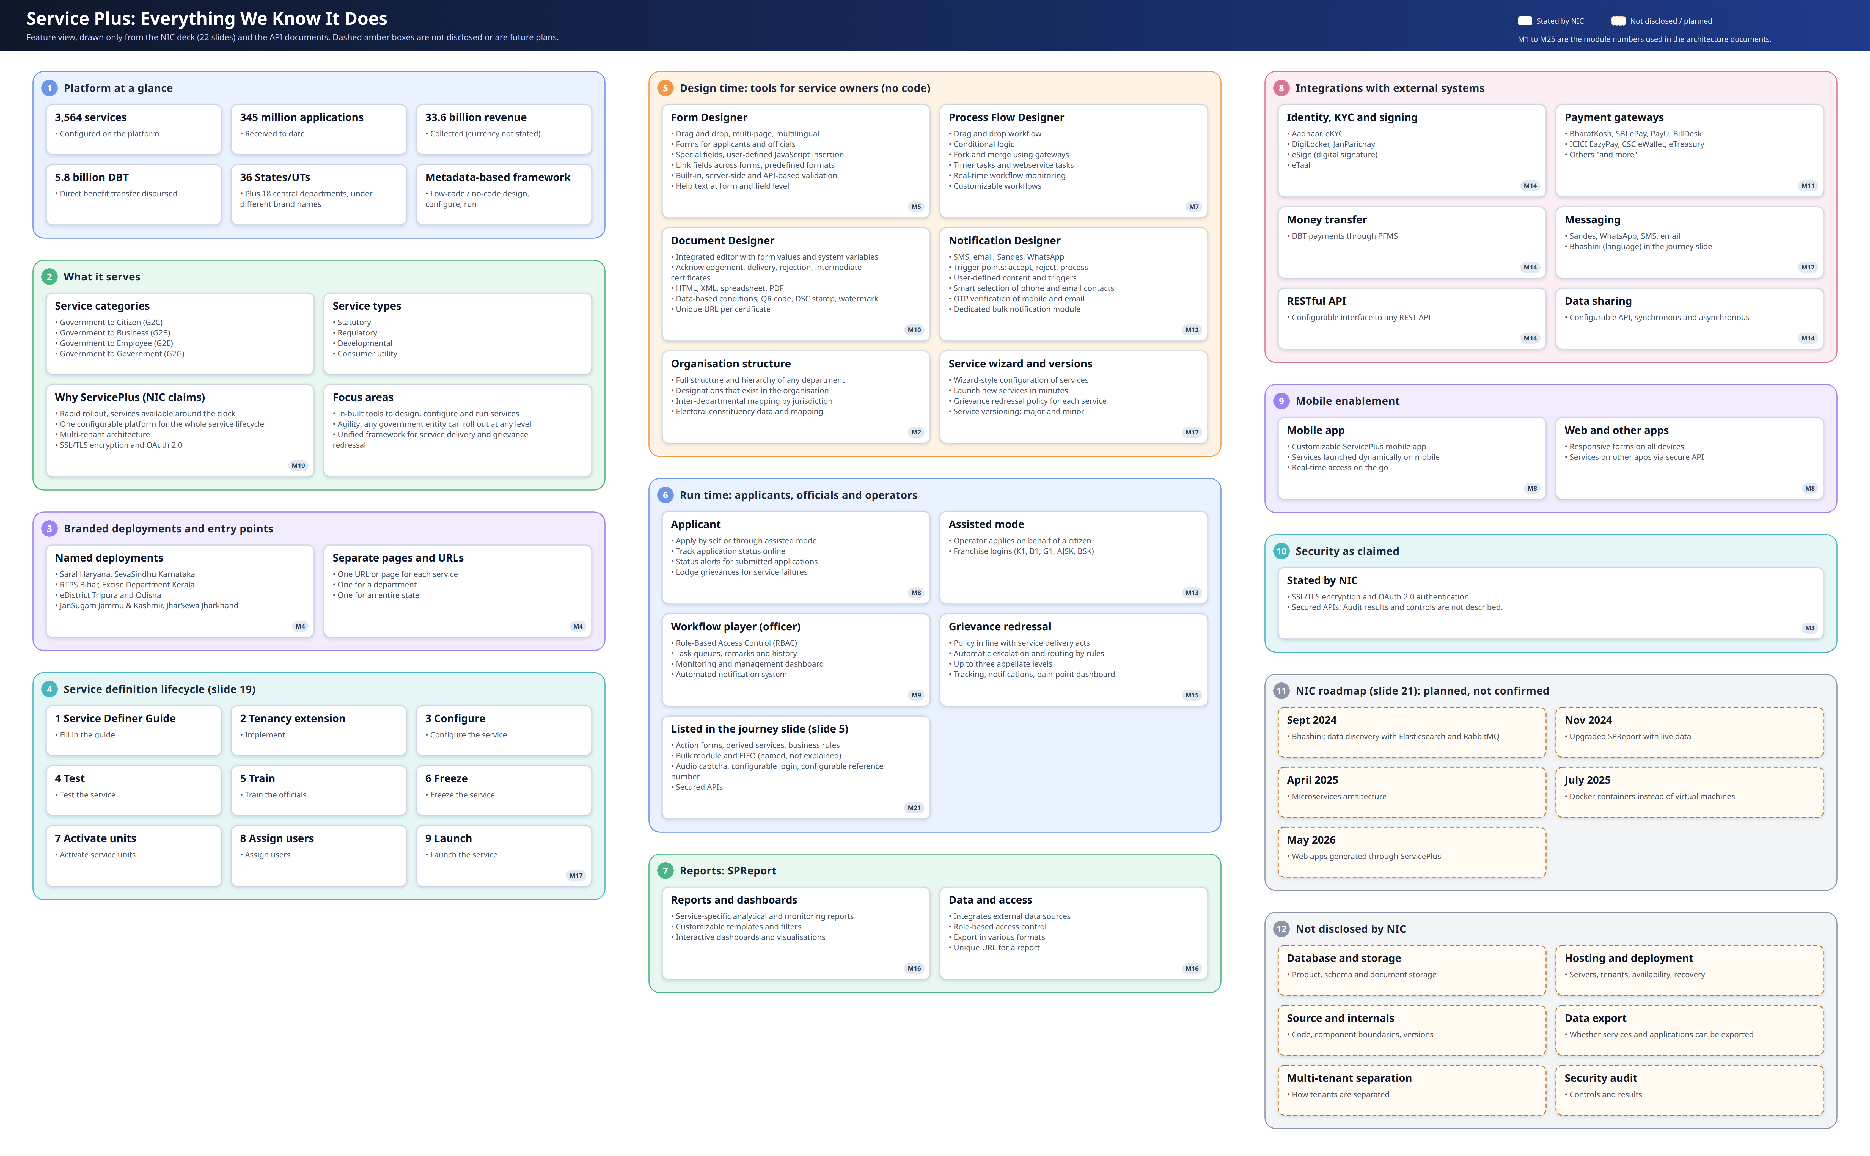

Slide 5
Five gaps could stop or delay the project
Migration
No inside view
Hosting and approvals
Outside connections
Ownership
Existing applications, service settings and users may not be exportable.
We know the platform only from a deck, one call and API notes. No code, data design or test system.
Hosting is undecided. Security and compliance clearances are not yet identified.
Identity, signing, payment and message links need approvals in our name. Departments need redirecting.
No named owners for fees, deadlines, appeals and signing authority.
We need from EDCS
We need from EDCS
We need from EDCS
We need from EDCS
We need from EDCS
Export route and who may release it
Test environment and API contract
Hosting choice and audit list
Sponsor letters and credential process
One named owner per department
Full list of ten blockers and twelve clarity items is in the Gaps and Blockers document.

Slide 6
The ten blockers and who can answer them
# | Blocker | Why it could stop us | Who can answer
1 | Data migration | Existing applications may not be exportable | Government, current platform owner
2 | Service settings | No known export; scripts may not translate | Government, service owners
3 | User migration | Unknown how users are held and sign in | Government, identity owners
4 | No inside view | No code, data design or test system | Government, current platform owner
5 | Hosting | Cannot size, price or plan recovery | Government
6 | Outside connections | Approvals and credentials take long | Government, each provider
7 | Integrated departments | Their addresses and allow-lists must change | Departments
8 | Signing validity | Signer authority and old certificates unclear | Government, legal
9 | Rule owners | Nobody approves fees and deadlines | Departments
10 | Security approvals | Audits and clearances not identified | Government, security reviewers
Source: Gaps and Blockers document, 19 October 2026.

Slide 7
Twelve questions to settle first
Size
How many services, users and documents; the busiest day
Officer work
What each action means; who is picked when a role is shared
Payments
Gateways, refunds, money taken but case not saved
Messages
Channels in use, approved senders, consent rules
Time limits
How days count, when they pause, who gets escalations
Appeals
The law, who may appeal, within what time
Operators
How centres are approved; wallets and commissions
Reports
Meaning of pending, overdue, disposed; who sees names
Languages and access
Languages on each screen; accessibility standard
History and recovery
How long records stay; recovery targets
Support
Who helps citizens and officers, and to what level
Existing mobile app
Plan for the period both platforms run
These would not stop work today, but each needs an answer first.

Slide 8
Proposed architecture: one front door, one core
Citizen web portal
Mobile app
Operator console
Officer workspace
Admin and Service Studio
Edge: reverse proxy and web firewall (TLS, security headers, rate limits)
WSO2 API Manager: the one front door. Token checks, throttling, versions, developer portal
WSO2 Identity Server: sign-in, OTP, roles from postings, tokens
Identity and offices
accounts, offices, access
Service setup
catalogue, forms, rules, publishing
Application work
workflow, tasks, appeals, time limits
Documents and money
certificates, payments, messages
Platform and support
reports, audit, migration
PostgreSQL
Redis
Kafka events
Object storage
OpenSearch
Reporting store
WSO2 Micro Integrator: every outside link, with retries and an owner
External: Aadhaar · DigiLocker · eSign · payment gateways · PFMS · SMS and WhatsApp · departments

Slide 9
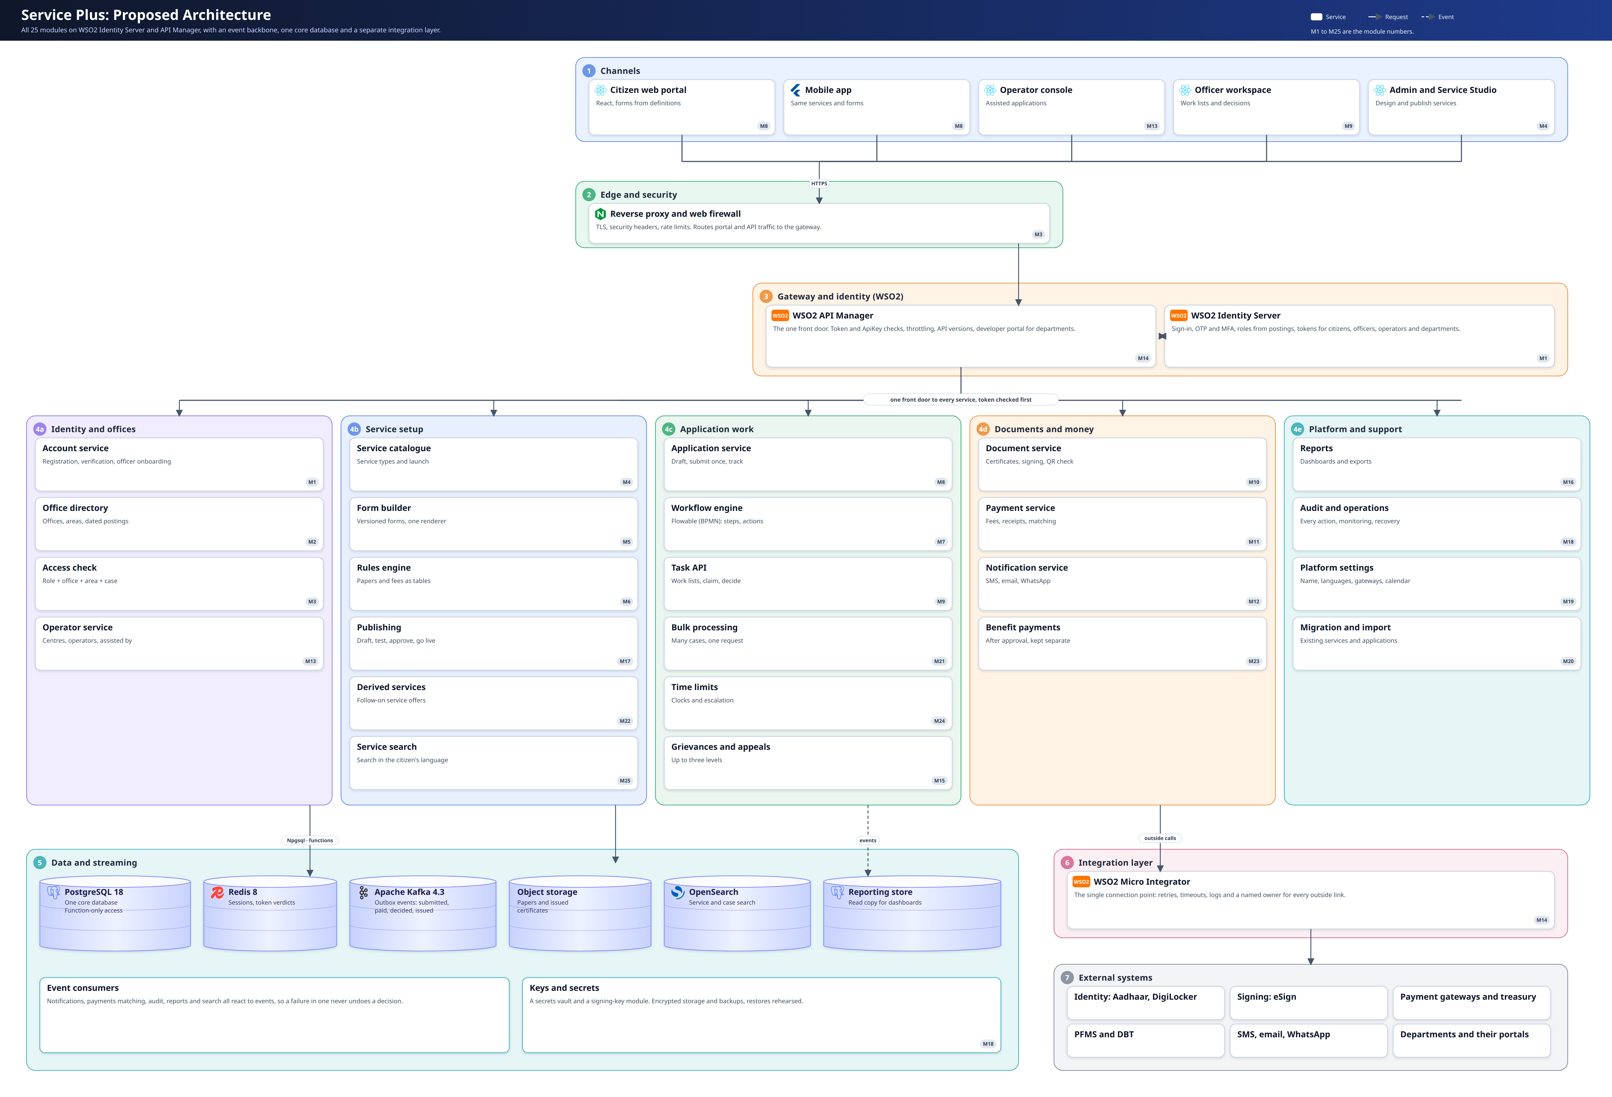

Slide 10
Twenty-five modules in five groups
Identity and offices
Service setup
Application work
Documents and money
Platform and support
M1 Accounts
M2 Office directory
M3 Access check
M13 Operators
M4 Service catalogue
M5 Form builder
M6 Rules engine
M17 Publishing
M22 Derived services
M25 Service search
M7 Workflow engine
M8 Applications
M9 Task API
M15 Grievances and appeals
M21 Bulk processing
M24 Time limits
M10 Documents
M11 Payments
M12 Notifications
M23 Benefit payments
M16 Reports
M18 Audit and operations
M19 Platform settings
M20 Migration and import
M14 Integration layer
Module numbers match the architecture documents. Proposed, not yet approved by the owner.

Slide 11
One request, end to end
1
2
3
4
5
Citizen
submits on web or mobile
Edge
TLS, rate limits
API Manager
checks token and limits
Access check
role, office, area, case
Application service
saves once
Event published to Kafka (outbox, so none is lost)
Notifications
Payment matching
Audit
Search index
Reports
A failure in any consumer is retried and never undoes the decision already made.
Why it matters: payment, notification and reporting problems cannot silently change an application outcome.

Slide 12
Security in layers
Edge
TLS, security headers, web firewall, rate limits
Identity
OTP and multi-factor sign-in; roles come from official postings
Gateway
Token and API-key checks, throttling, API versions
Services
Every call checked by role, office, area and case
Data
Encrypted storage; database reached only through functions; backups with rehearsed restores
Keys and audit
Secrets vault; signing keys held apart; every action logged and never edited
Proposed controls. Security audits and clearances still have to be identified with the government.

Slide 13
How the design closes those gaps
Gap | How the proposed design responds
Migration | A migration module imports services, users and applications. Original application numbers and certificate QR checks keep working.
No inside view | A three-service pilot builds the real mapping before the full build starts.
Hosting undecided | Open components with no vendor lock-in, so the platform runs on whatever host the government chooses.
Outside connections | One integration layer. Each link has a named owner, retries and logs.
Unclear service rules | Versioned forms and a rules engine owned by departments. Publishing needs a separate approval.
Signing and security | A separate signing-key module, a secrets vault, and an audit record of every action.
Proposals for discussion. None of these is a settled government decision.

Slide 14
SOP 1: Putting a service live
1
2
3
4
5
6
7
Define
Department records purpose, eligibility, fees, documents
Configure
Service owner builds form, steps, certificate, messages
Review rules
Department head checks fees and approval route
Test
Test team runs real cases end to end
Approve
Approving authority signs off the launch
Train
Officials trained on the new service
Publish
Platform admin makes it live and versioned
Amber border: approval gate. A rejection returns the service to Configure.
Output
A signed service definition and a rule register, kept with every version.
Controls
Whoever drafts a service cannot publish it. Every change creates a new version.
Owner
Each department names who approves rules, fees and launch.

Slide 15
SOP 2: Handling an application
1
2
3
Complete?
4
5
6
Submit
Citizen or operator
Pay fee
If the service has one
Scrutiny
Officer checks papers
Yes
Decide
Authority approves or rejects
Certificate
Signed, QR code, unique URL
Notify
SMS, email
No
Ask citizen to correct
Time limits
Every step has a clock. Overdue cases escalate to the next officer. Days are set by each department.
Money and decision apart
Payment status never decides approval. A rejection needs a written reason and shows the appeal route.
Record
Every action is logged with who, when and why. Records cannot be edited.

Slide 16
SOP 3: Grievances and appeals
1
2
3
Resolved?
Yes
Close and notify citizen
Lodge
Citizen raises a grievance online or at a centre
Acknowledge
Reference number sent by SMS
Decide
Grievance officer replies within the set time
No
First appeal
Next senior officer
Second appeal
A different officer
Third appeal
Final authority
Each level can resolve and close the case. An unresolved case moves up.
Law and time
Who may appeal and within what time follows the applicable act. To be confirmed with each department.
Tracking
Citizen sees the level, the officer and the deadline. Escalation is automatic when a deadline passes.
Insight
Dashboards show which services draw the most grievances.

Slide 17
SOP 4: Onboarding citizens and officers
Citizen
1
2
3
4
Register
Mobile or email
Verify
OTP sent and entered
Activate
Identity check if needed
Sign in
Token issued
Officer
1
2
3
4
Request
Department admin raises it
Record posting
Office, role, start date
Create account
Roles follow the posting
First sign-in
Multi-factor set up
On transfer
Access moves with the new posting. Earlier actions keep the original officer name.
Absence
Acting arrangements recorded with dates.
Leaving
Account closed the same day; history stays.

Slide 18
SOP 5: Connecting a department
1
2
3
4
5
6
Request
Department asks to integrate
Agree
Scope, contacts, IP allow-lists
Issue keys
API key from developer portal
Test
Department tests in a sandbox
Approve
Go-live sign-off
Monitor
Calls, errors and limits watched
Amber border: approval gate.
Moving existing departments
Today they call fixed addresses. Each address is redirected at an agreed time and both sides update their allow-lists.
Ownership
Each outside link has a named owner, retries, timeouts and logs in the integration layer.
Limits
Throttling and API versions are set per department so one cannot slow the others.

Slide 19
SOP 6: Incident and recovery
1
2
3
4
5
6
Detect
Monitoring alert or user report
Triage
Set severity, name the lead
Contain
Pause the affected function only
Restore
Fix, or restore from backup
Verify
Check cases and payments
Review
Report cause and prevention
Amber border: needs the approval of the incident lead.
Payments in doubt
Stay pending until the provider confirms. Never guessed as paid or failed.
Decisions are safe
A notification or report failure never reverses a case decision.
Restores rehearsed
Backups are restored on a schedule, so recovery is tested before it is needed.

Slide 20
Way forward and what we need from EDCS
1 Discover and pilot
2 Build and connect
3 Migrate and cut over
Get export access to current data
Map three pilot services: one simple, one with several reviews, one with a fee and certificate
Name department owners
Core modules on the WSO2 stack
Outside connections, approvals started early
Security review before go-live
Import services, users and applications
Run old and new side by side
Switch department by department
Decisions we need from EDCS
Hosting choice for the new platform
Access to current data and a test environment
A named owner for each department
The list of integrations needed on day one
Approval of the three pilot services

